Slide 1

Business Analytics II (BIS 244 – Chapter 8 part 2)
Refine Your Plots
BIS 244 – Fall 2022 – Dr. Davoodi

Slide 2

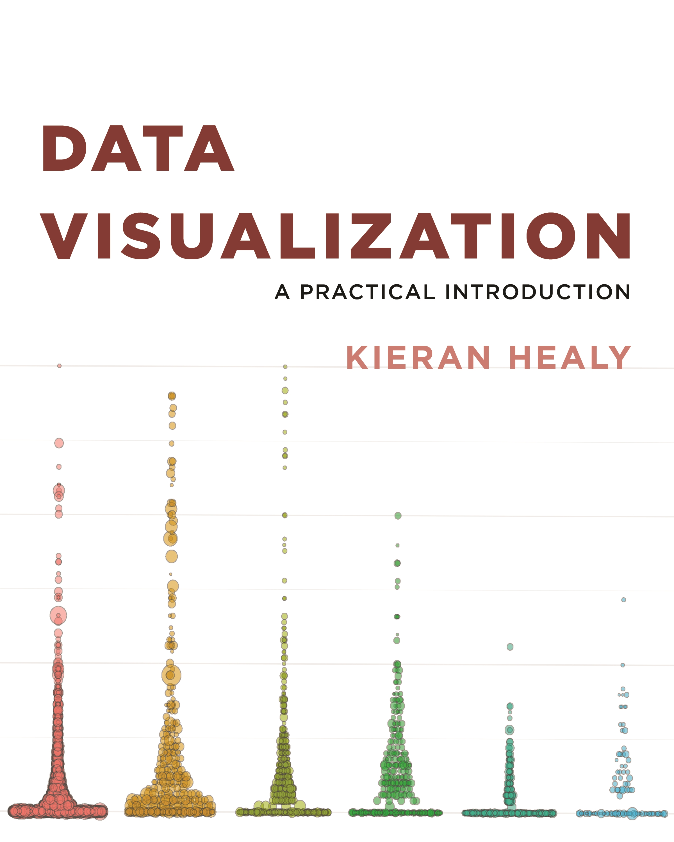
Chapter 8: Refine Your plot

Slide 3
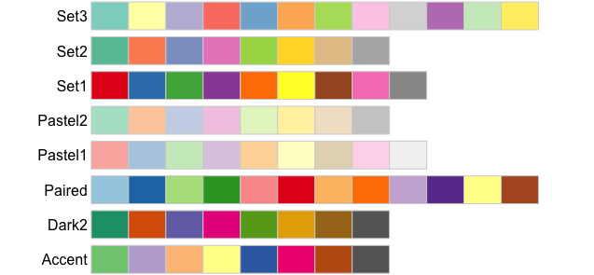
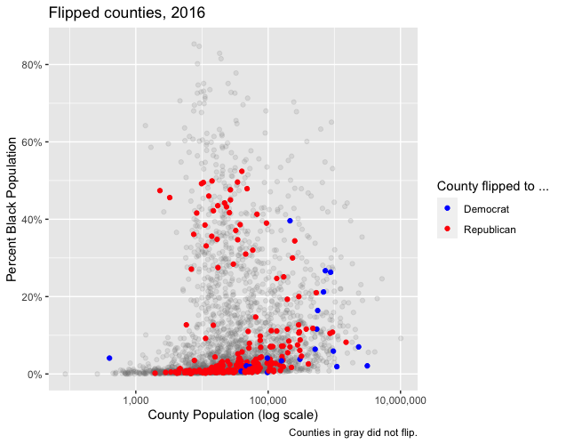
Review
In chapter 8, part 1, we discussed
If more analyses are needed, we may consider revising plots.
Sometimes revising plots is necessary to get insights.
We may use Color to get some advantages or to highlight some parts.
How to use different sets of colors.
How to highlight different parts of plots based on our hypotheses/questions.

Slide 4
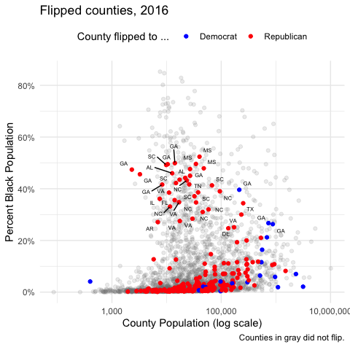
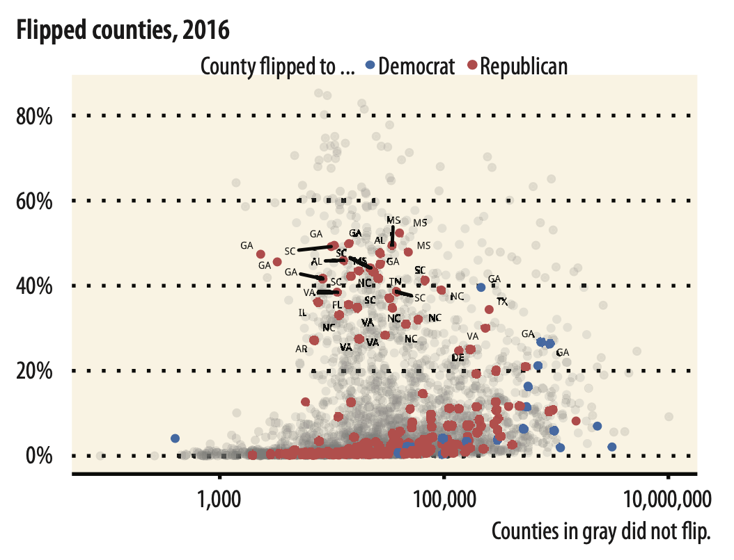
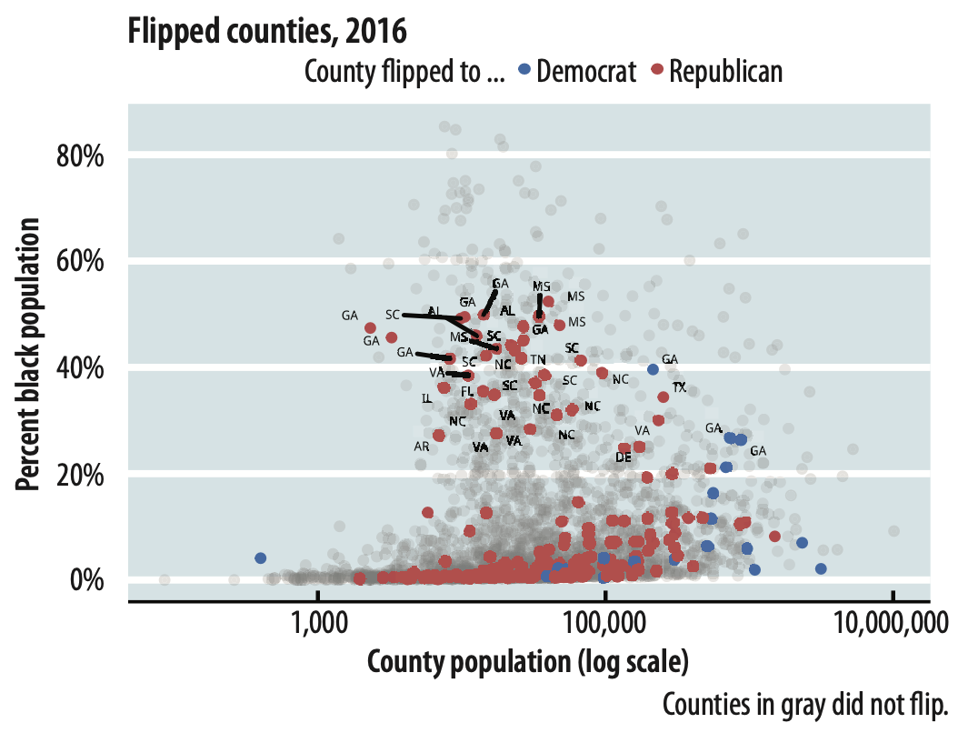
8.3 Change the Appearance of Plots with Themes
In the elections plot, we want to change the overall look
theme_set() function

Slide 5
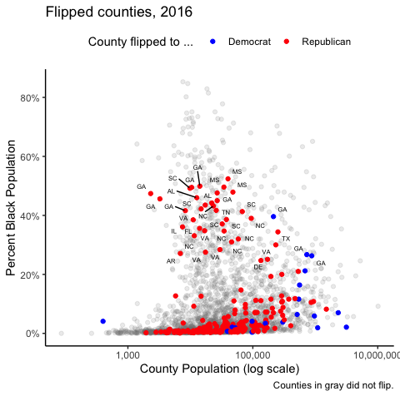
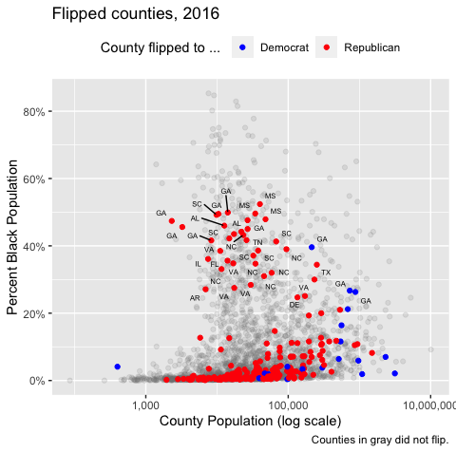
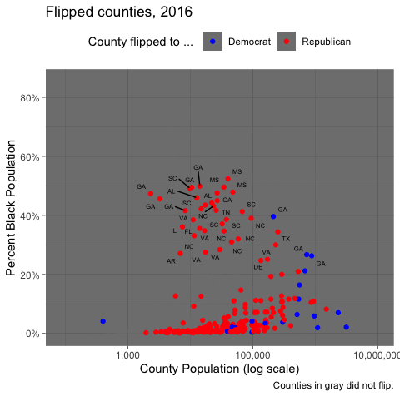
8.3 Change the Appearance of Plots with Themes
theme_set(theme_classic()): x and y axes
theme_set(theme_grey()): the default one
theme_set(theme_dark()): dark background

Slide 6
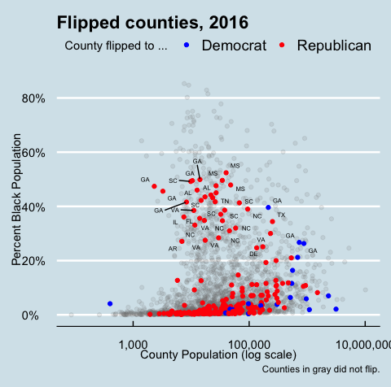
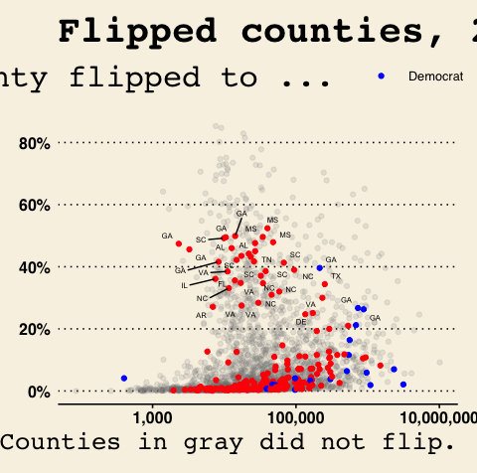
8.3 Change the Appearance of Plots with Themes
theme_economist()
theme_wsj()
Revision Needed

Slide 7
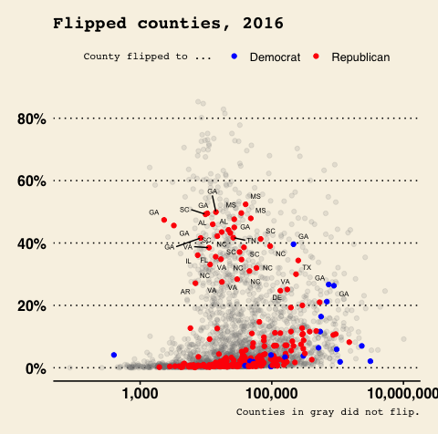
8.3 Change the Appearance of Plots with Themes
Revise the theme_wsj theme by changing text size

Slide 8
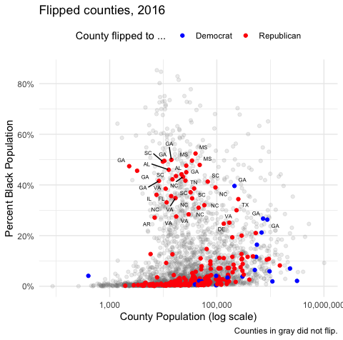
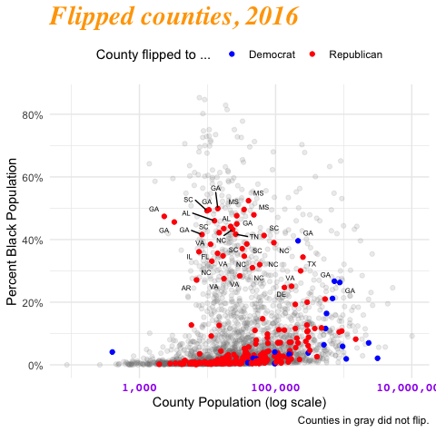
8.3 Change the Appearance of Plots with Themes
Revise the theme_minimal theme
Color, size, font type, and color of the title
Color, size, font type, and color of x axis

Slide 9
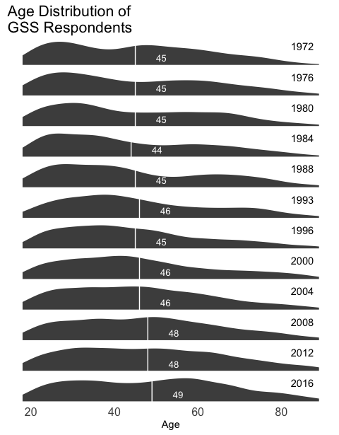
8.4 Use Theme Elements in a Substantive Way
gss_lon dataset: General Social Survey data, 1972-2016
Compare age distribution of respondents for some years.
Specify mean age for each year
…

Slide 10
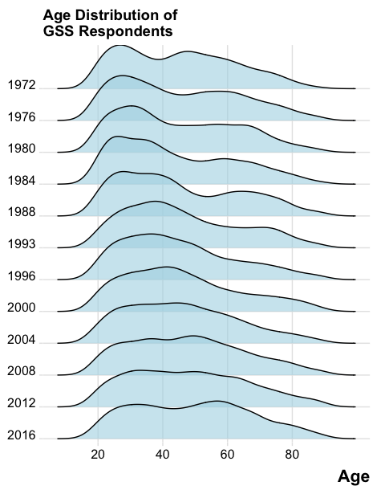
8.4 Use Theme Elements in a Substantive Way
library(ggridges)
ggridges package allows facets to overlap vertically

Slide 11
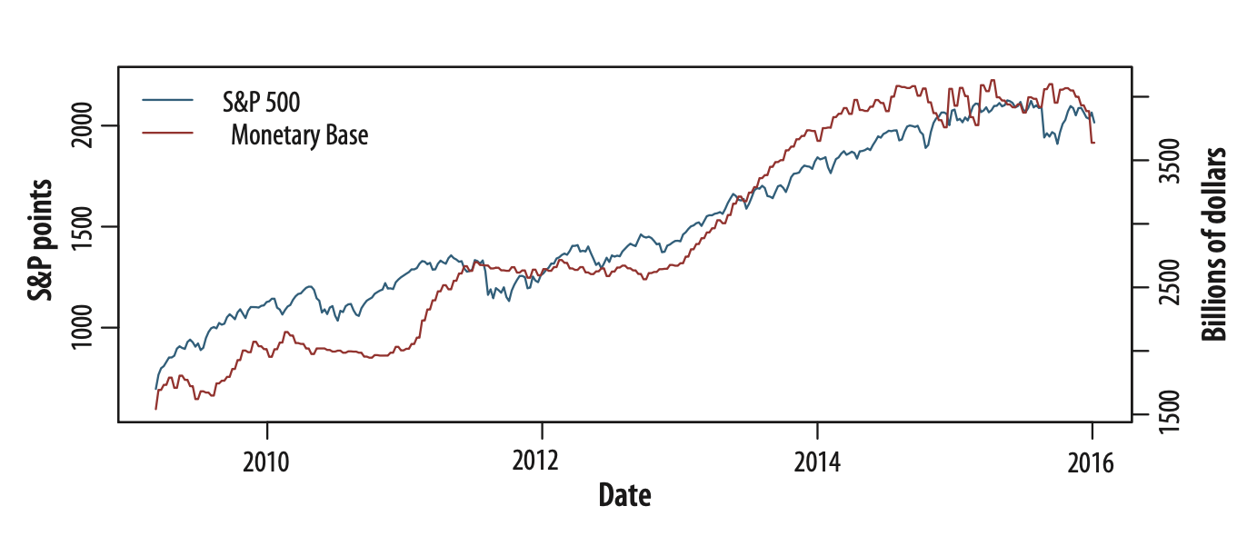
8.5 Case Studies
Bad graphics are everywhere.
Revise plots in new (and better) versions
Example 1:
S&P is an index that ranges from about 700 to about 2,100
Monetary Base ranges from about 1.5 trillion to 4.1 trillion dollars
The plot makes it even easier than usual to fool yourself (or someone else) about the degree of association between the variables

Slide 12
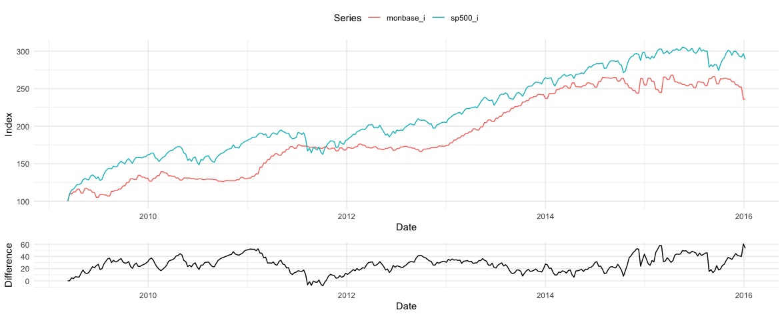
8.5 Case Studies
Rescale based on the first period
plot them

Slide 13
Summary
In chapter 8 part 2, we learned how to
Revise theme to create a better plot or customized plot
Change the Appearance of Plots with Themes
Set a theme for all plots by theme_set
Use theme elements in a substantive way
Use ggridges to allow overlapping
Revise plots

